Slide 1
The U.N. Sustainable Development Goals (SDGs)
https://sdgs.un.org/goals

Slide 2
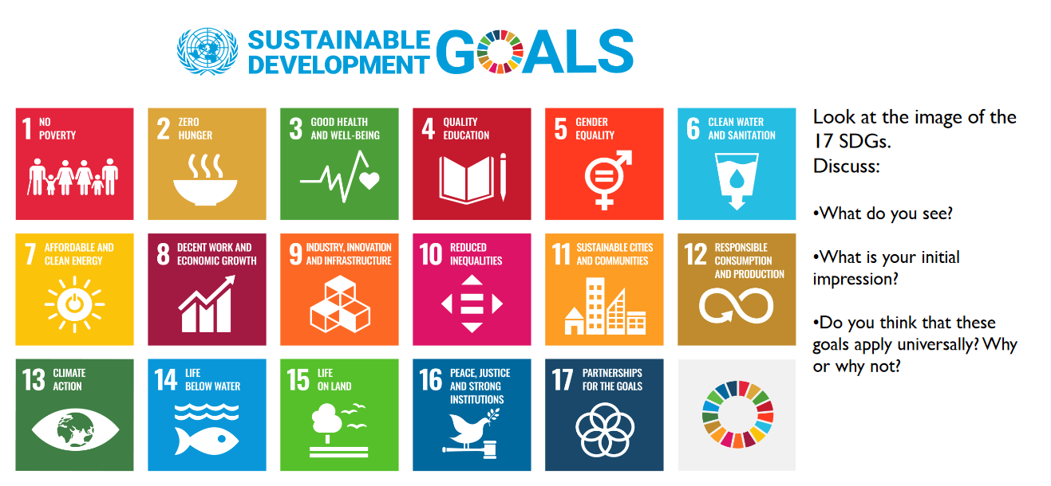
The U.N. Sustainable Development Goals (SDGs): Getting Started
https://www.un.org/sites/un2.un.org/files/sdg.09.01.23_final.pdf

Slide 3
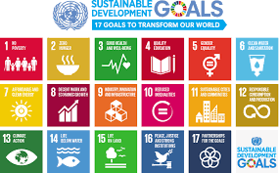
The U.N. Sustainable Development Goals (SDGs): Introduction and Overview
All United Nations Member States adopted the 2030 Agenda for Sustainable Development in 2015, which at its core contains the 17 Sustainable Development Goals (SDGs).
The SDGs address the many challenges that our global society is facing, including poverty, inequality, climate change, ecological damage, and peace and justice.
Educating business students (= future managers) about SDGs is crucial because it gives them the opportunity to take responsibility for their actions and commit to working together to build a better and more sustainable future for everyone.
https://sdgs.un.org/goals

Slide 4
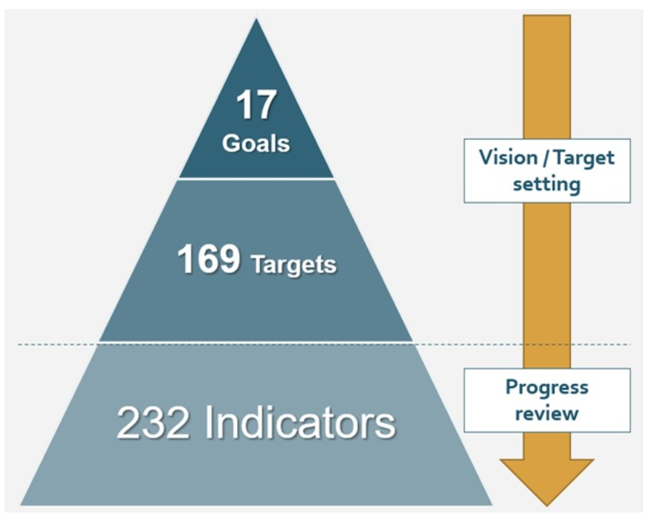
The U.N. Sustainable Development Goals (SDGs): Introduction and Overview
The framework of the SDGs comprises three layers including:
17 global goals, which represent the vision for the ideal sustainable world;
169 global targets, which set numerical targets and deadlines to reach the goals; and
232 global indicators, which review the progress of SDGs actions against global targets.
https://sdgs.un.org/goals
https://blog.bham.ac.uk/cityredi/implementing-sustainable-development-goals-sdgs-the-lessons-for-cities-from-international-examples/

Slide 5
https://www.un.org/sites/un2.un.org/files/sdg.09.01.23_final.pdf

Slide 6
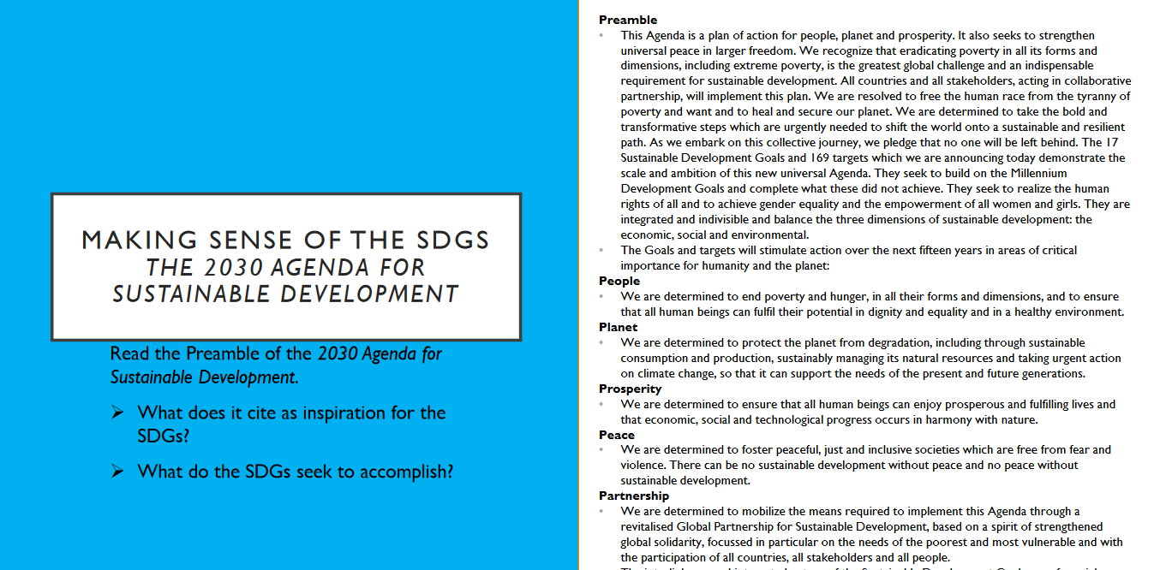
https://www.un.org/sites/un2.un.org/files/sdg.09.01.23_final.pdf

Slide 7
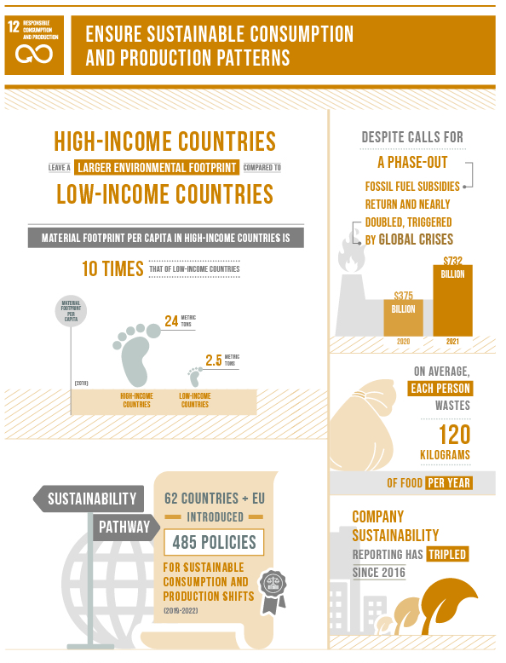
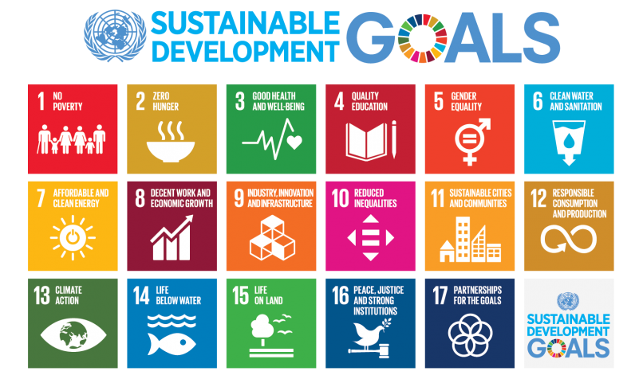
The U.N. Sustainable Development Goals (SDGs): SGD 12: Ensure sustainable consumption and production patterns
FOCUS:
SDG 12
https://www.un.org/sustainabledevelopment/sustainable-consumption-production/

Slide 8
The U.N. Sustainable Development Goals (SDGs): SGD 12: Ensure sustainable consumption and production patterns
Goal 12 is about ensuring sustainable consumption and production patterns, which is key to sustain the livelihoods of current and future generations.
Our planet is running out of resources, but populations are continuing to grow. If the global population reaches 9.8 billion by 2050, the equivalent of almost three planets will be required to provide the natural resources needed to sustain current lifestyles.
We need to change our consumption habits, and shifting our energy supplies to more sustainable ones are one of the main changes we must make if we are going to reduce our consumption levels. However, global crises triggered a resurgence in fossil fuel subsidies, nearly doubling from 2020 to 2021.
We are seeing promising changes in industries, including the trend towards sustainability reporting being on the rise, almost tripling the amount of published sustainability over just a few years, showing increased levels of commitment and awareness that sustainability should be at the core of business practices.
Food waste is another sign of over consumption, and tackling food loss is urgent and requires dedicated policies, informed by data, as well as investments in technologies, infrastructure, education and monitoring. A staggering 931 million tons of food is wasted a year, despite a huge number of the global population going hungry.
https://www.un.org/sustainabledevelopment/sustainable-consumption-production/

Slide 9
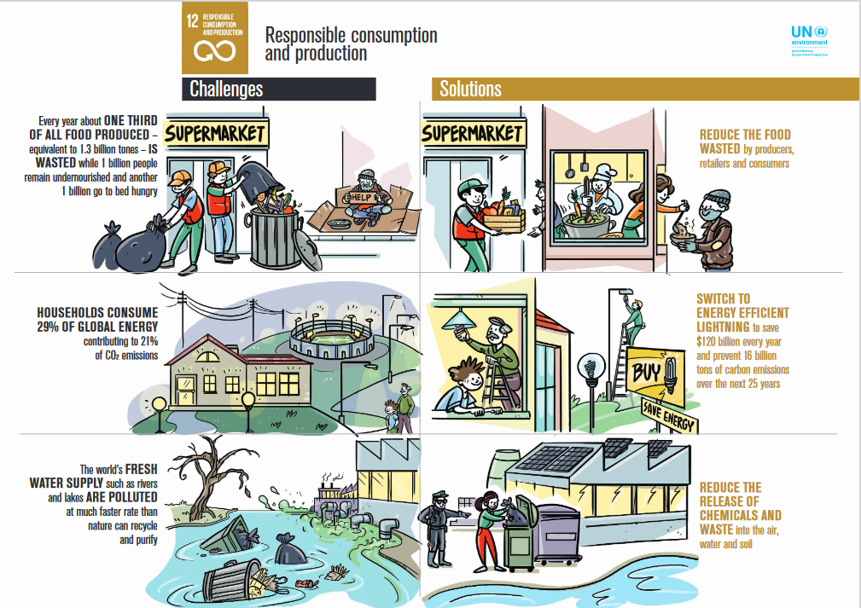
The U.N. Sustainable Development Goals (SDGs): SGD 12: Ensure sustainable consumption and production patterns
https://wedocs.unep.org/bitstream/handle/20.500.11822/22747/12_Responsible%20consumption%20and%20production_FINAL.pdf?sequence=1&isAllowed=y

Slide 10
The U.N. Sustainable Development Goals (SDGs): SGD 12: Ensure sustainable consumption and production patterns
Why do we need to change the way we consume?
Economic and social progress over the last century has been accompanied by environmental degradation that is endangering the systems on which our future and survival depend.
A successful transition means improvements in resource efficiency, consideration of entire life cycle of economic activities, and the need for multilateral environmental agreements.
What needs to change?
There are many aspects of consumption that with simple changes can have a big impact on society as a whole.
Governments need to implement/enforce policies and regulations that include measures such as reducing waste, promoting circular economy and sustainable procurement policies
Transitioning to a circular economy involves designing products for longevity, repairability, and recyclability. It also involves promoting practices such as reusing, refurbishing, and recycling products to minimize waste and resource depletion.
Individuals can adopt more sustainable lifestyles, e.g.: consuming less, choosing products with lower environmental impacts, and reducing carbon footprint of day-to-day activities.
https://www.un.org/sustainabledevelopment/sustainable-consumption-production/

Slide 11
The U.N. Sustainable Development Goals (SDGs): SGD 12: Ensure sustainable consumption and production patterns
How can a business help?
It’s in businesses’ interest to find new solutions that enable sustainable consumption and production patterns. A better understanding of environmental and social impacts of products and services is needed, both of product life cycles and how these are affected by use within lifestyles.
Innovation and design solutions can both enable and inspire individuals to lead more sustainable lifestyles, reducing impacts and improving well-being.
How can consumers help?
There are two main ways to help:
Reducing waste and
Being thoughtful about what purchases and choosing sustainable options when possible.
Ensuring they don’t throw away food, and reduce consumption of plastic (key pollutant of oceans). Carrying a reusable bag, refusing to use plastic straws, and recycling plastic bottles are good ways to help every day.
Making informed purchases; e.g., buying from sustainable and local sources to make a difference as well as exercising pressure on businesses to adopt sustainable practices.
https://www.un.org/sustainabledevelopment/sustainable-consumption-production/

Slide 12
The U.N. Sustainable Development Goals (SDGs): Let’s Look at (Some of the) Targets
The framework of the SDGs comprises three layers including:
17 global goals, which represent the vision for the ideal sustainable world;
169 global targets, which set numerical targets and deadlines to reach the goals; and
232 global indicators, which review the progress of SDGs actions against global targets.
TARGETS
https://sdgs.un.org/goals
https://blog.bham.ac.uk/cityredi/implementing-sustainable-development-goals-sdgs-the-lessons-for-cities-from-international-examples/

Slide 13
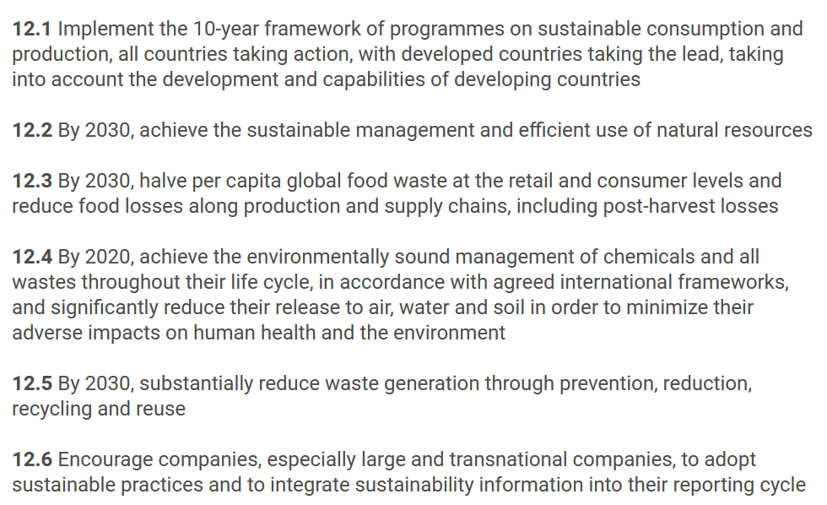
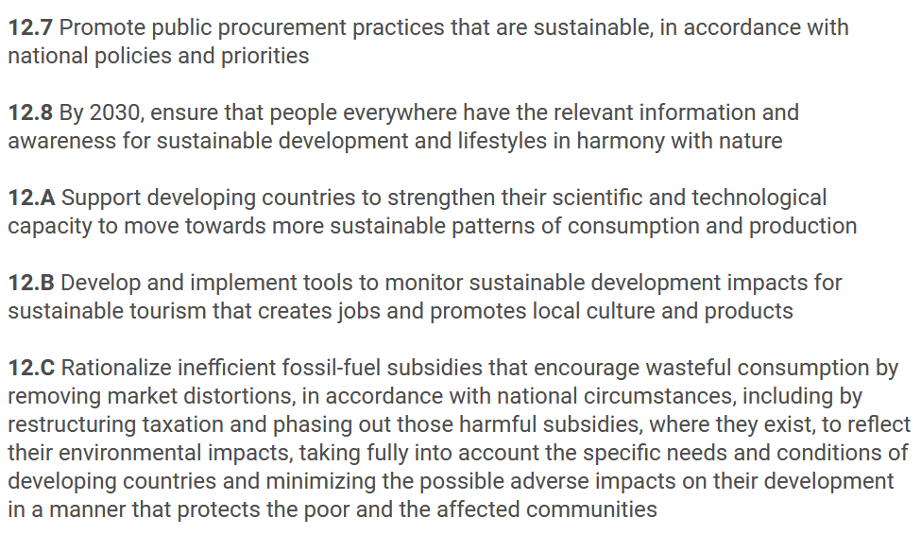
The U.N. Sustainable Development Goals (SDGs): SGD 12: Consider Target 12.2
https://www.un.org/sustainabledevelopment/sustainable-consumption-production/

Slide 14
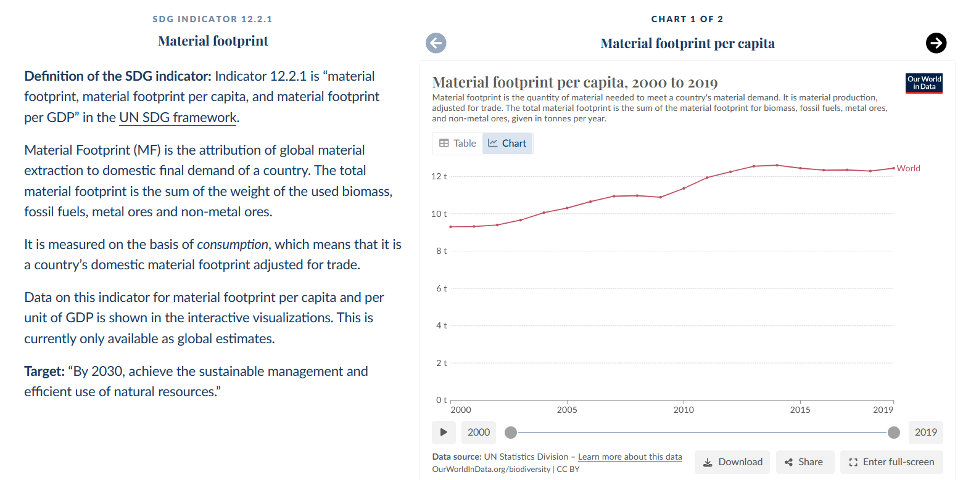
The U.N. Sustainable Development Goals (SDGs): SGD 12: Illustrative Focus on Target 12.2 and Indicator 12.2.1: Sustainable Management and Use of Natural Resources
https://ourworldindata.org/sdgs/responsible-consumption-production

Slide 15
The U.N. Sustainable Development Goals (SDGs): SGD 12: Illustrative Focus on Target 12. 3 (Food Waste)
https://www.un.org/sustainabledevelopment/sustainable-consumption-production/

Slide 16
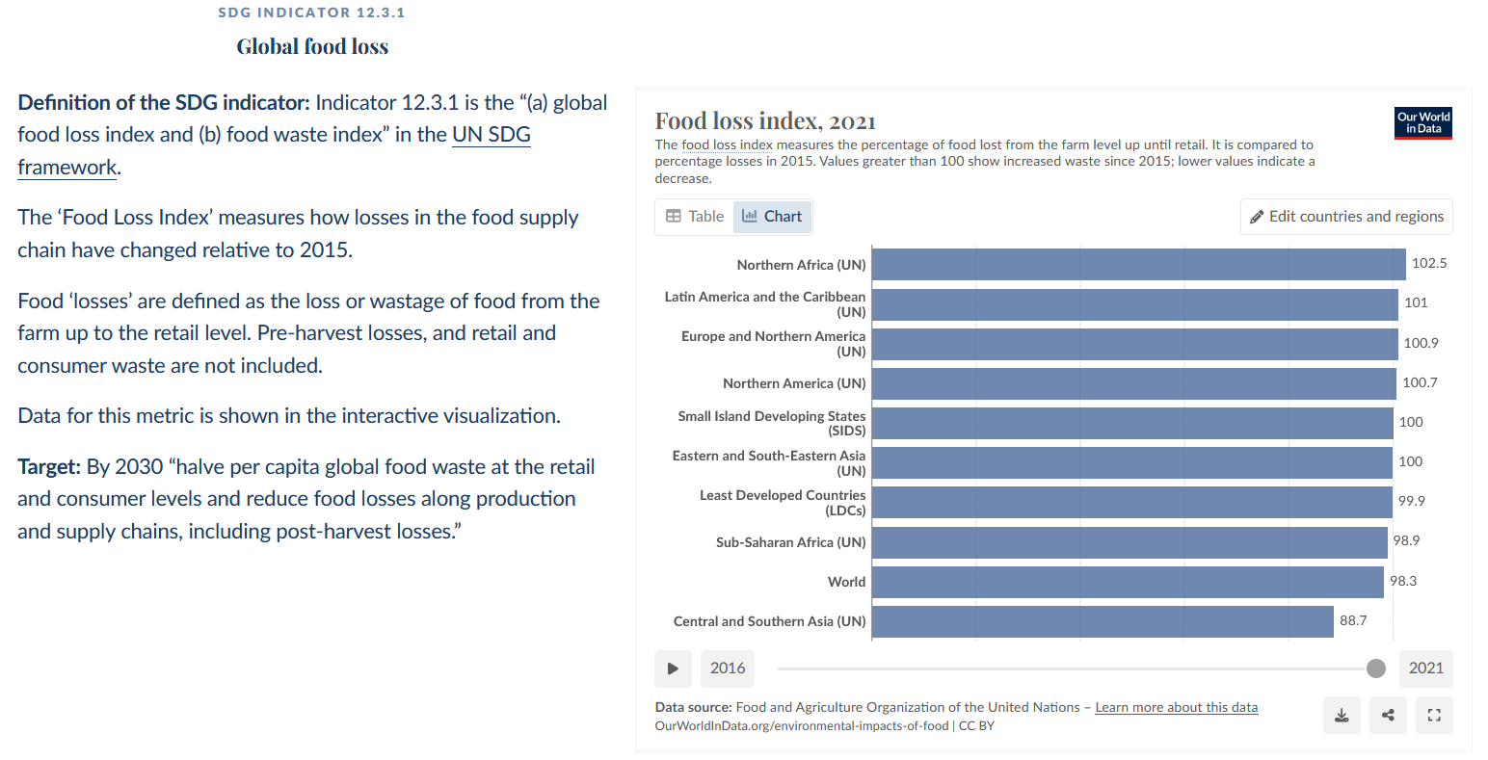
The U.N. Sustainable Development Goals (SDGs): SGD 12: Illustrative Focus on Target 12.3 and Indicator 12.3.1
https://ourworldindata.org/sdgs/responsible-consumption-production

Slide 17
The U.N. Sustainable Development Goals (SDGs): SGD 12: Illustrative Focus on Target 12.5 (Waste Generation)
https://www.un.org/sustainabledevelopment/sustainable-consumption-production/

Slide 18
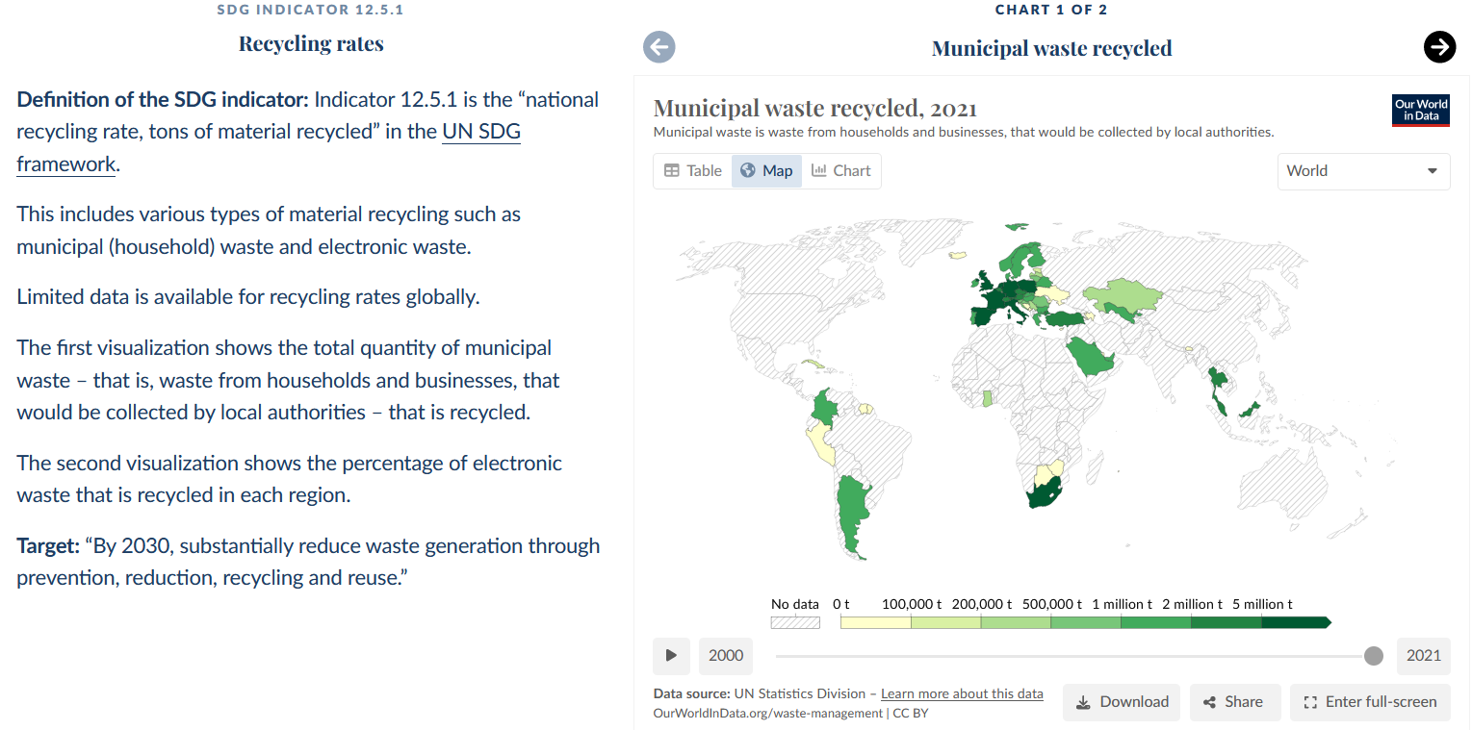
The U.N. Sustainable Development Goals (SDGs): SGD 12: Focus on Target 12.5 and Indicator 12.5.1
https://ourworldindata.org/sdgs/responsible-consumption-production

Slide 19
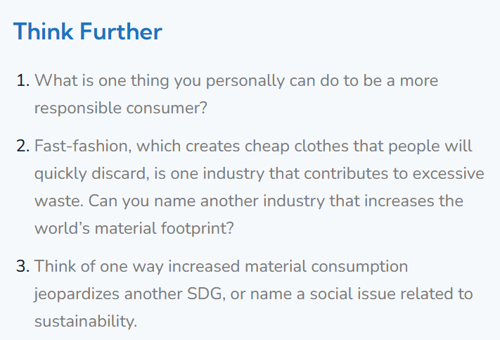
The U.N. Sustainable Development Goals (SDGs): SGD 12: Thinking Further
https://academy4sc.org/video/sustainable-development-goal-12-responsible-consumption-and-production/

Slide 20
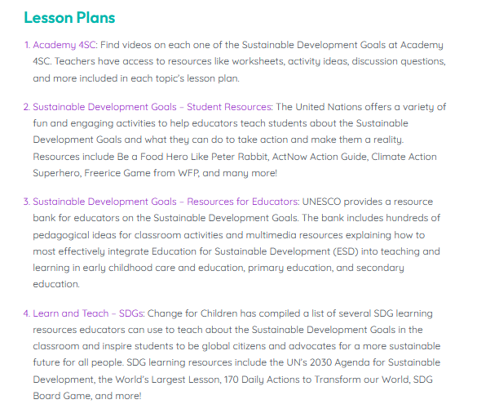
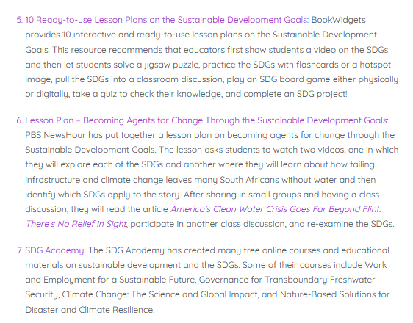
Additional Teaching Resources
https://educators4sc.org/teaching-about-the-sustainable-development-goals/

