Slide 1
Teaching & Learning
Marketplace Diversity and Inclusion
For instructors: refer to notes box for detail on slide contents where requires
These teaching materials are a product of collective knowledge and expertise of Multicultural Marketplaces Network, with contributors as follows: Dr Carlo Mari (University of Molise, Italy), Dr Samantha N. N. Cross (Babson College, USA), Professor Eva Kipnis (University of Bradford, UK), Dr Cristina Galalae (Open University Business School, UK), Professor Charles Chi Cui (University of Westminster, UK), Emma Johnson, PhD Candidate, (Sheffield University Management School, UK), Dr Shauna Kearney (Birmingham City University, UK), Dr Tana Licsandru (Queen Mary University of London, UK), Dr Verónica Martín Ruiz (University of Massachusetts Amherst, USA), Dr Lizette Vorster (Aarhus University, Denmark), Dr Irem Yoruk (California State University Los Angeles, USA).
www.multicultural-marketplaces.net

Slide 2
Contents
Understanding diversity
Understanding multicultural marketplaces
Why diversity matters?
Understanding exclusion-inclusion
Understanding equity
How diversity, inclusion, belonging, and equity (DIBE) impact the marketing mix

Slide 3
Diversity
Variety of ‘cultural markers’ of identity: cultural origins/heritage (racial background, ethnicity, nationality, migration status), sexual orientation, gender identity, religious affiliation, socioeconomic status, (dis)ability, appearance (body shape, size, facial features, maternal body), age, neurostatus, social role…
Variety of ‘forms of being’
Presence and representation of difference

Slide 4
Task
Take 5 minutes and write down your ‘multicultural story’. Consider: what ‘cultural markers’ characterize you as a person? what experiences with culture(s) other than your own did you have? where?
Notes:
We recommend to assure students that they will not be required to share their ‘story’, to enable free reflection. Once students complete the task, offer the next slide.

Slide 5
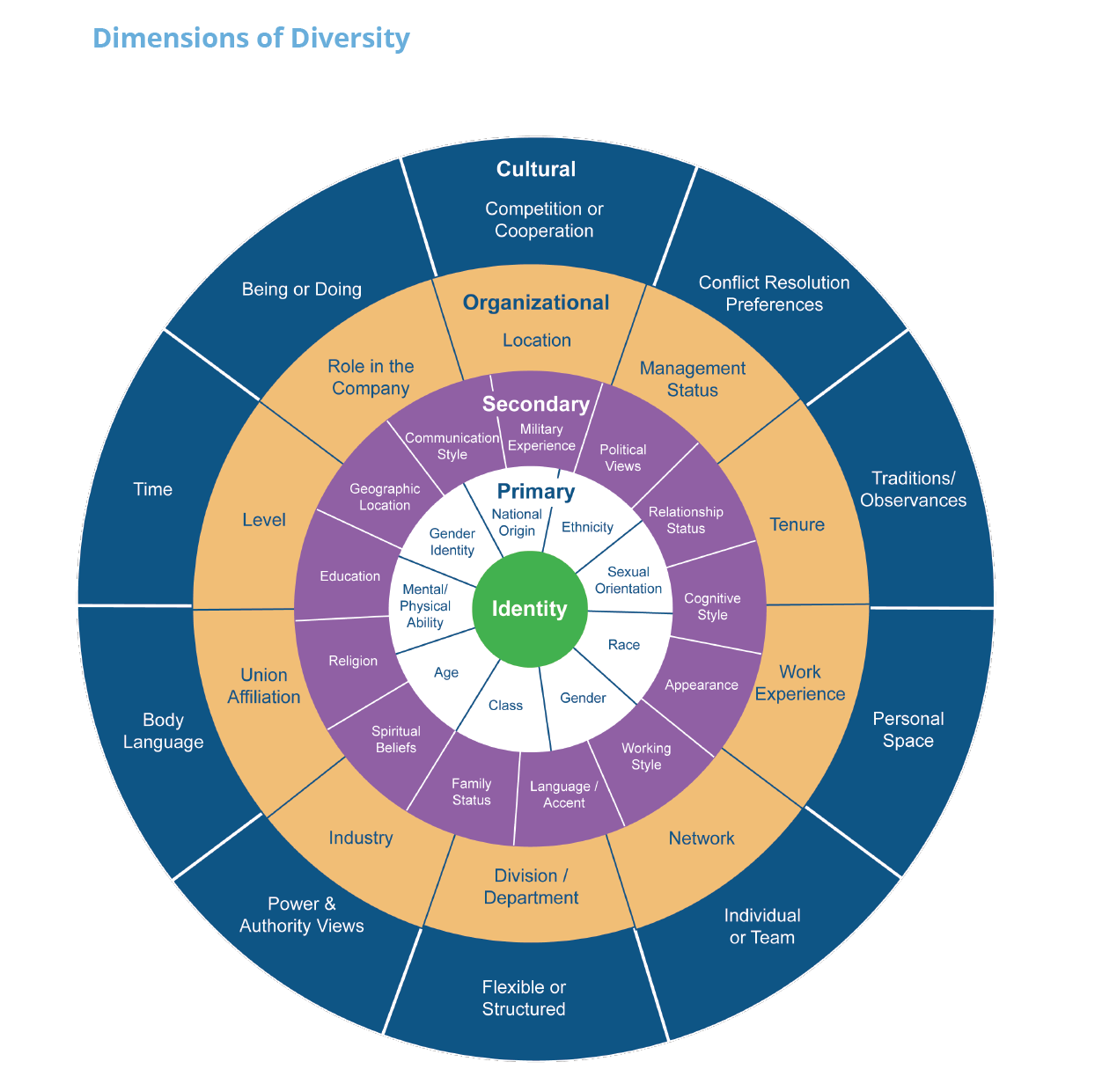
Source: Adapted from Workforce America! By Marilyn Loden and Judy Rosener, 1991; Diverse Teams at Work by Lee Gardenswartz and Anita Rowe, 2003; and Global Diversity Puts New Spin on Loden’s Diversity Wheel by Kimberley Lou and Barbara Dean, 2010.
Notes:
Invite students to compare their ‘story’ against the dimensions of diversity represented here. Invite them to recognize that people can acquire dimensions of diversity as they move through life.

Slide 6
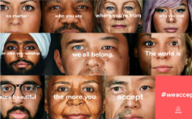
Q: Why consider diversity in the marketplace?
A: The marketplace makes many of our lived environments
Notes:
Utilise examples provided or replace with your own examples to demonstrate how diversity manifests in the marketplace.

Slide 7
Task
Search online for examples of adverts or organizations’ websites and consider whether and how diversity is reflected in these examples.
Notes:
If adapting to postgraduate student audience, consider introducing instruction of identifying organizational reports in this exercise.

Slide 8
Multicultural Marketplace
A major social arena where different cultural markers come together in a variety of co-existing manifestations (people: consumers, frontline staff), artifacts (brands, media, organizations) and ideologies.
Sources: Demangeot et al. 2019; Kipnis et al. 2021

Slide 9
Multicultural Marketplaces are interconnected
Consider the following two stories:
Source: Galalae et al. 2023
Notes:
Feel free to adapt the two to your own context (such as environment, school, courses, etc.).

Slide 10
Graphically, we see connections between multicultural marketplaces
Source: Galalae et al. 2023
Notes:
For illustration, the x-axis in the chart plots three cultural difference dimensions (racial background, ability, and sexual orientation) underlying the experience of discrimination identified in the opening stories; the y- and z-axes plot the micro- and macrosocial context expressions. Each axis includes other expressions, illustrating that more configurations are possible.
The first story recounting discrimination experiences by a “Black, gay, and queer man” (microsocial expressions: boxes C, G, and I) in “a majority-White area” of a “gentrifying and racially segregated urban neighborhood” with common “law enforcement” stereotyping (macrosocial expressions: boxes 1, 3, and 5) encompasses a configuration of prejudices and oppressions mobilized in relation to racial background and sexual orientation.
The second story presents the experiences of a “disabled Asian” Kenyan female (microsocial expressions: boxes A and D), entailing a configuration mobilized in relation to (dis)ability (CDD) through in/outgroup prejudicial ideologies (macrosocial expressions: boxes 7, 8, and 9). Both accounts detail discrimination within a focal multicultural marketplace (USA, Kenya), enabled by intersecting microsocial and macrosocial context expressions.
Transspatial context expressions (e.g., sociocultural discourses) can flow from other marketplaces (see the chart).

Slide 11
Q: Why should organizations and brands care about diversity?

Slide 12
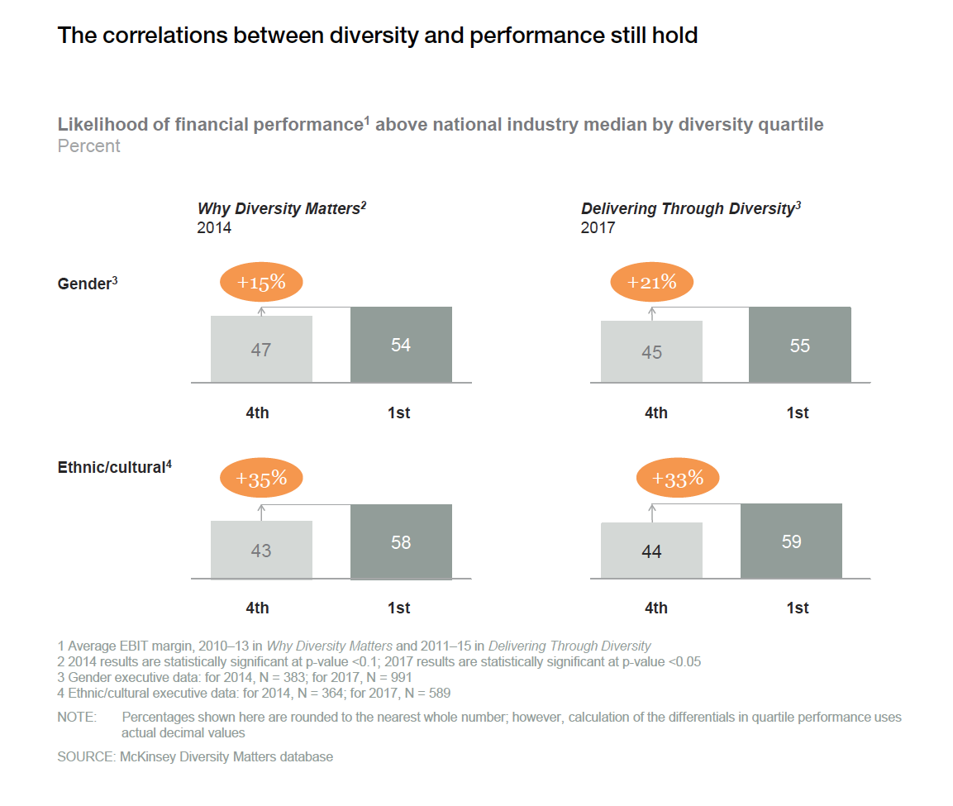
The Right Thing To Do and Good Business
Mars’s 2017 ad campaign for its Maltesers brand in the UK featuring people with disabilities twice exceeded targets:
8% vs target 4% for brand growth
20% vs target 10% for brand affinity

Slide 13
But…
Promoting diversity does not ensure a culture of inclusion
Source: McKinsey (2020)

Slide 14
Exclusion
An economic and social experience of inequality and injustice that has implications for quality of life and social cohesion.
Certain individuals and communities experience barriers to accessing the resources and opportunities (goods, services, jobs), and/or participating in relationships and activities (representation, networks) provided by the market to other people in the society.
Notes:
Explain that, to understand what inclusion is, it is helpful to consider what it is NOT.

Slide 15
Top 10
Inclusive for all: a global social values-driven consumer trend
56%
Of UK youth would hesitate to accept a job if organisation lacks DEI track record
70%
US Hispanic and Black workers said company should be doing more to increase diversity
Inclusion: the sense of “I/we matter here”
$900 bn
Annual purchasing power of the LGBTQIA+ consumers in the USA
£4.5 bn
Annual purchasing power of multi-ethnic people in the UK
$5 tln
Projected annual purchasing power of people of 60 in Europe by 2030
15%
Population of the European Union are people with disabilities
Notes:
Inclusion is about all people (individuals and communities) feeling that they matter. It has become a core topic of focus for businesses and consequently marketers.
Inclusion coming into this sharp focus is facilitated by two factors: 1) it is now an expectation held by both external and internal stakeholders [first line of illustrations – in the UN Sustainable Development Goals three goals – Nos 5, 10 and 16 relate to inclusion agenda] and 2) the growing business case for inclusion as ‘missed market share opportunities’ [second line of illustrations].

Slide 16
Consequently, core priority for marketers!
"Negative, diminished conceptions of women and girls are one of the greatest barriers for gender equality […] Advertising is a particularly powerful driver to change perceptions and impact social norms.“
(Phumzile Mlambo-Ngcuka, Unstereotype Alliance and Former Executive Director of UN Women)

Slide 17
Facets of Inclusion
Inclusion is conceptualized as involving Uniqueness and Belongingness.
Uniqueness: Personal component (defining oneself as an individual).
Belongingness: Social identification (the need to form and maintain strong, stable interpersonal relationships).
Consumption experiences in the marketplace show that consumers usually acquire and display goods for a twofold purpose: they want to feel different from others, but at the same time desire to belong to a specific group.
Source: Shore et al., (2011), Journal of Management.

Slide 18
Equity
It means to remove barriers in the marketplace so that everyone has equal access to and participate in consumption practices.
It means to eradicate consumer discrimination in the marketplace and assure a fair treatment to everyone.

Slide 19
Task
Please provide examples of marketplace discrimination that you
or others in your network have experienced or related to you.

Slide 20
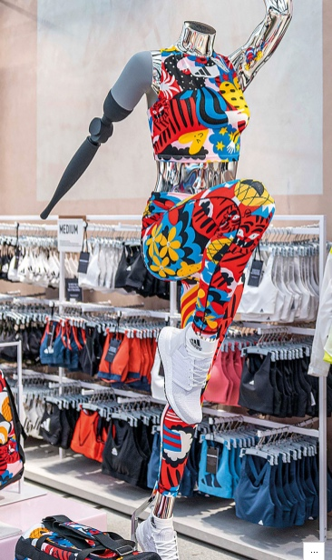
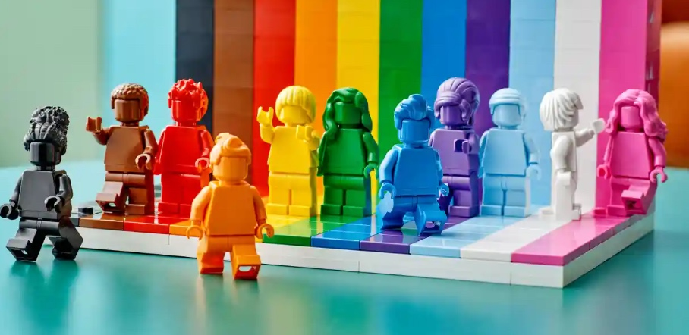
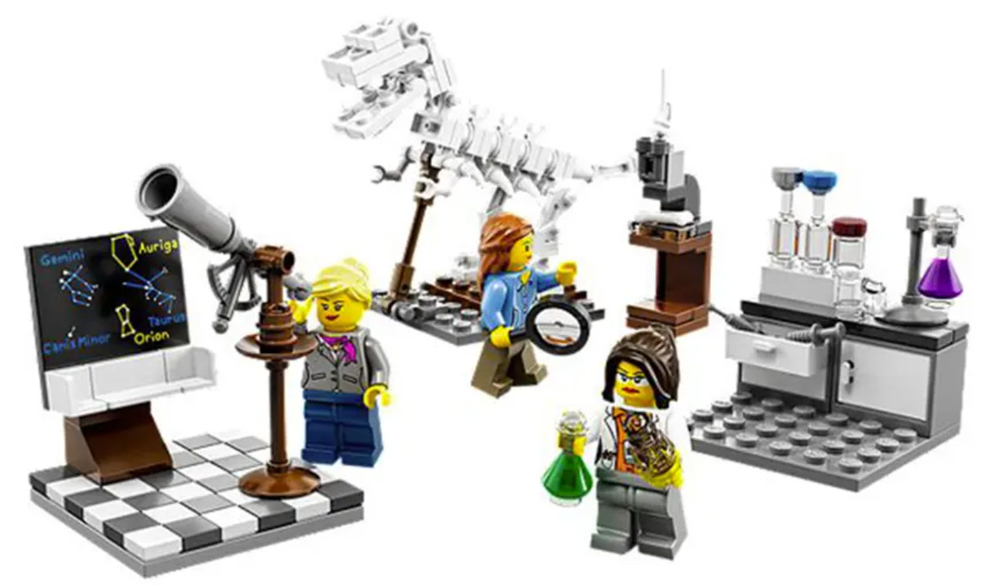
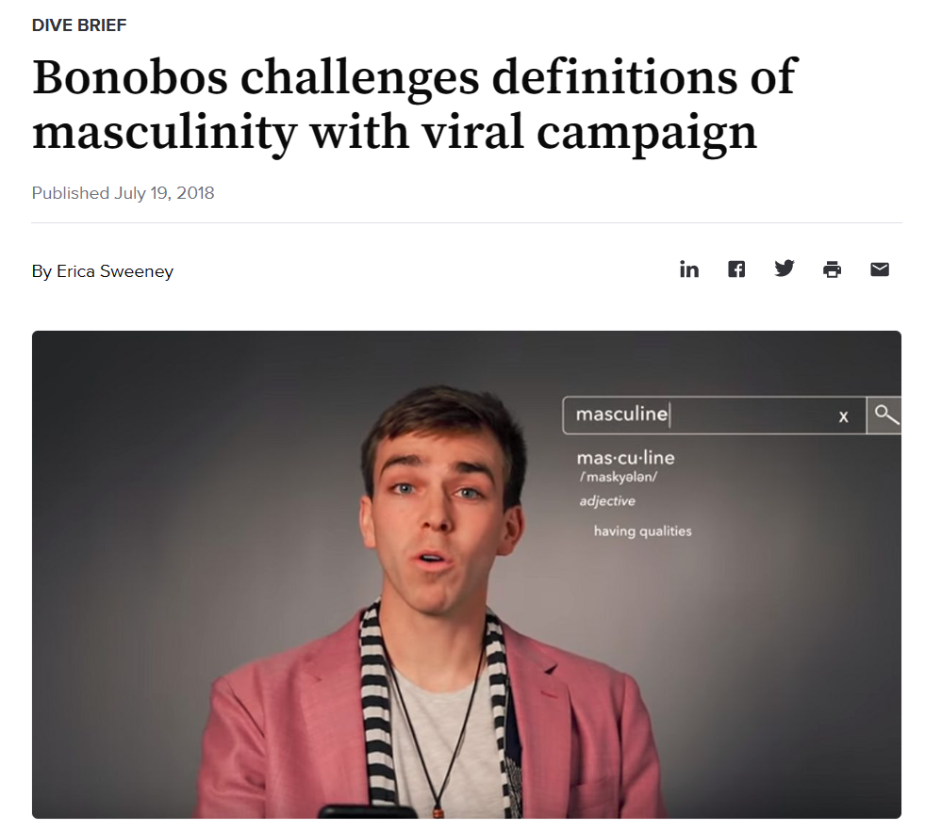
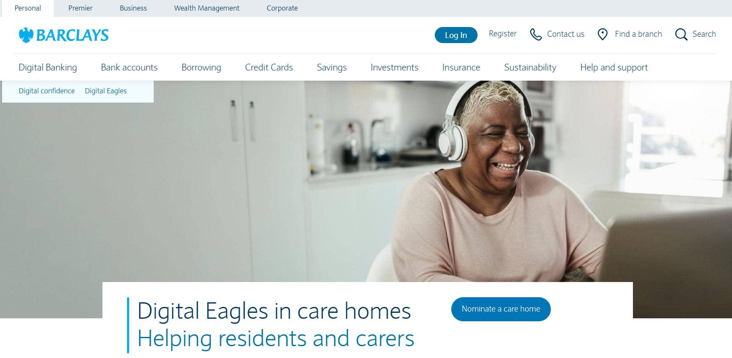
DIBE as a driver of marketing innovation
PRODUCT
PLACE
PROMOTION
PEOPLE
PROCESS
PHYSICAL
EVIDENCE
PRICE
…
Notes:
The demand for inclusion is also offering a wider field for innovation across marketing mix. This innovation is necessary to avoid ‘woke washing’ perceptions by consumers which can and do arise if firms/brands only focus on advertising. Go through examples (below) or replace with your own.
Product: Lego’s ‘rainbow’ people and lab set with female scientists (latter –a response to a letter from a young girl asking why there aren’t any female scientists in the sets).
Place: mannequin for adaptive clothing display, Morrison’s (a UK supermarket chain) introducing quieter hours for people with sensory disabilities.
Promotion: various unstereotyping initiatives – Bonobo’s example of male representation.
People: initiatives for diverse talent acquisition and development, including in marketing agencies.
Process: Barclays’s bank launching a Digital Eagles initiative to support elderly consumers with learning digital banking skills.
Physical evidence: many brands diversifying their packaging as a signal of inclusivity of different consumers.
Price: pink tax. Tampons – taxes on female products have been problematic as these are treated as luxury items, but this is gender biased. The pink tax has been linked to “period poverty” – e.g., price barriers to accessing menstrual products."

Slide 21
Task
Please provide examples of brands addressing Diversity, Inclusion, Belonging, and Equity across marketing mix variables.

Slide 22
These teaching materials are a product of collective knowledge and expertise of
Multicultural Marketplaces Network, with contributors as follows:
Dr Carlo Mari (University of Molise, Italy)
Dr Samantha N. N. Cross (Babson College, USA)
Professor Eva Kipnis (University of Bradford, UK)
Dr Cristina Galalae (Open University Business School, UK)
Professor Charles Chi Cui (University of Westminster, UK)
Emma Johnson (PhD Candidate, Sheffield University Management School, UK)
Dr Shauna Kearney (Birmingham City University, UK)
Dr Tana Licsandru (Queen Mary University of London, UK)
Dr Verónica Martín Ruiz (University of Massachusetts Amherst, USA)
Dr Lizette Vorster (Aarhus University, Denmark)
Dr Irem Yoruk (California State University Los Angeles, USA)

Slide 23
Teaching & Learning
Marketplace Diversity and Inclusion
Teaching notes
These teaching materials are a product of collective knowledge and expertise of Multicultural Marketplaces Network, with contributors as follows: Dr Carlo Mari (University of Molise, Italy), Dr Samantha N. N. Cross (Babson College, USA), Professor Eva Kipnis (University of Bradford, UK), Dr Cristina Galalae (Open University Business School, UK), Professor Charles Chi Cui (University of Westminster, UK), Emma Johnson, PhD Candidate, (Sheffield University Management School, UK), Dr Shauna Kearney (Birmingham City University, UK), Dr Tana Licsandru (Queen Mary University of London, UK), Dr Verónica Martín Ruiz (University of Massachusetts Amherst, USA), Dr Lizette Vorster (Aarhus University, Denmark), Dr Irem Yoruk (California State University Los Angeles, USA).
www.multicultural-marketplaces.net

Slide 24
These accompanying notes are designed to support the
instructors in designing and/or teaching their own courses on marketplace diversity and inclusion

Slide 25
Contents
What to study
How to study
General challenges in teaching
Addressing (some of the) barriers

Slide 26
What to study
Teaching the language of marketplace diversity and inclusion (defining core terms and using them correctly).
Clarifying the meaning and linkages among diversity, inclusion, belonging, and equity under the broader umbrella of social justice and multicultural education.
Valuable sources:
Adams M., Bell L.A., Goodman D.J., Shlasko D., Briggs R.R., Pacheco R. (2023). Teaching for Diversity and Social Justice, 4th edition, Routledge. → Particularly chapter 1, 2, 3, 4.
Fuentes M.A., Zelaya D.G., Madsen J.W. (2021). Rethinking the course syllabus: considerations for promoting equity, diversity, and inclusion. Teaching of Psychology, 48(1), 69-79.
Iverson S.V. (2012). Multicultural competence for doing social justice: expanding our awareness, knowledge, and skills. Journal of Critical Thoughts & Praxis, 1(1), 62-87.
Mor Barak M.E. (2015). Inclusion is the key to diversity management, but what is inclusion? Human Service Organizations: Management, Leadership & Governance, 39, 83-88.

Slide 27
What to study
Emphasizing that multicultural marketplaces bring in an extended version of diversity, which incorporates many subtle dimensions very often neglected.
Students need to grasp the idea that diversity comes in a variety of forms and that intersectionality can play a key role in shaping marketplace diversity and inclusion issues.
Valuable sources:
Gopaldas A. (2013). Intersectionality 101. Journal of Public Policy & Marketing, 32(Special issue), 90-94.
Williams J.D. and Henderson G.R. (2012). Discrimination and injustice in the marketplace. They come in all sizes, shapes, and colors. In Mick D.G., Pettigrew S., Pechman C., and Ozanne J.L. (Eds.) Transformative consumer research for personal and collective well-being , Routledge, 171-189.

Slide 28
What to study
Adopting a holistic perspective for designing the course content such as the three interrelated pillars: knowing, caring, and acting.
Valuable source:
Banks J.A. (2019). An Introduction to Multicultural Education, 6th Edition, Pearson. → Particularly chapter 1, 2, 3, 4.

Slide 29
What to study
More on a holistic perspective, particularly on the contribution of each pillar to develop a multicultural mindset.
Knowing → Content knowledge specific to the course taught and related to marketplace diversity and inclusion.
Caring → Developing an empathetic commitment in the marketplace.
Acting → Translating into concrete actions what has been learned about marketplace diversity and inclusion.

Slide 30
What to study
This is a partial list of topics that might be covered in a marketing course. Its breadth and depth depend on the specific course taught.
Identities in the marketplace
Intersecting identities in the marketplace
Dynamics of power, privilege, and oppression in the marketplace
Multicultural competence in the marketplace
Business vs. moral case for diversity
Brand representation

Slide 31
How to study
Prioritizing teaching methods focused on thinking critically and active experimentation.
Self-reflection (for example My multicultural story or My experience of marketplace diversity and inclusion)
Critical analysis (for example Exploring how brands represent diversity and inclusion)
Experiential activities (for example Team-based project)

Slide 32
How to study
The following sources (ten articles) provide practical examples of teaching methods employed by other instructors to address marketplace diversity and inclusion:
Chang, D. R. (2020). Using films to achieve diversity goals in marketing education. Journal of Marketing Education, 42(1).
Chio, V.C.M., Fandt, P.M. (2007). Photovoice in the diversity classroom: Engagement, voice, and the “eye/I” of the camera. Journal of Management Education, 31(4), 484–504.
Edmondson, B.S., Edmondson, V.C., Adams, J., Barnes, J. (2020). We challenge you to join the movement: From discourse to critical voice. Journal of Management Education, 44(2), 247–266.
Everett S., Gunduc M., Junjunia M., Kroener L., Maise J., Scott-Hyde K., Salem L., Simsek A. (2023). Transformational learning: using equality and diversity marketing client briefs to foster awareness, application and action. Marketing Education Review, 33(1), 56-75.
Grier S. A. (2020). Marketing inclusion: a social justice project for diversity education. Journal of Marketing Education, 42(1), 59-75.

Slide 33
How to study
Hartwell E.E., Cole K., Donovan S.K., Greene R.L., Burrell Storms S.L., Williams T. (2017). Breaking Down Silos: Teaching for Equity, Diversity, and Inclusion Across Disciplines. Humboldt Journal of Social Relations, 39, 143-162.
Litvin, D.R., Betters-Reed, B.L. (2005). The personal map: A lesson in similarities, differences, and the invisible. Journal of Management Education, 29(2), 199–217.
Pierce, M.E., Longo, J.L. (2020). Incorporating photovoice in the marketing curriculum to increase cultural competence. Journal of Marketing Education, 42(1).
Rivera R.G., Arrese A., Sádaba C., Casado L. (2020). Incorporating diversity in marketing education: a framework for including all people in the teaching and learning process. Journal of Marketing Education, 42(1), 37-47.
Young, C.A., Haffejee, B., Corsun, D.L. (2018). Developing cultural intelligence and empathy through diversified mentoring relationships. Journal of Management Education, 42(3), 319–346.

Slide 34
General challenges in teaching
A study by our Multicultural Marketplaces Network indicates a range of barriers one may experience when looking to introduce a course addressing Marketplace diversity and inclusion:
Lack of support by the institution
Space in the current curriculum
Students reaction to the topic
Instructor awareness / command of the topic
Complexity of topic
Availability of teaching materials

Slide 35
Addressing (some of the) barriers - I
Addressing students reaction to the topic when designing a course and managing teaching situations:
Selecting course content that is relevant for all students, both underrepresented and ‘majority’, so that any of them can contribute to the learning experience.
Creating a safe and welcoming environment that helps starting difficult conversations particularly when the institution has a predominantly white demographics. Pre-class readings is one approach to set up such an environment.
Exploring more perspectives of each topic, in an objective way, to enrich the class discussion. Helping students to reflect on both polarized views and pragmatic middle-ground approaches.

Slide 36
Addressing (some of the) barriers - II
Diversity and Inclusion Engaged Marketing Initiative
Addressing instructors’ need of resources and knowledge exchange on teaching this complex topic:
Diversity and Inclusion Engaged Marketing (DIEM) is an initiative by Multicultural Marketplaces Network. Our purpose is to:
Accumulate and bring together knowledge and best practices of promoting inclusion through marketing from marketing science, education and practice
Foster collaborations for developing and promoting DIEM as a distinct area of knowledge and practice
Publications by our network, available https://multicultural-marketplaces.net/our-work/publications/ cover the concepts of multicultural marketplace wellbeing and DIEM
Our curation of literature, available https://multicultural-marketplaces.net/diem-initiative/diem-reading-list/ provides a reading list on various dimensions of diversity

