Slide 1

Consumer Poverty

Slide 2

Topic Overview
Poverty, dimensions and income
“Myths” of poverty
Poverty in consumer culture
Poverty and consumption
Major poverty issues examined in consumer research
Consumption adequacy and resource trajectories
Consumer well-being pathways
Questions for further consideration

Slide 3
Poverty
Poverty has often been understood as something that happens to other people (them not us).
Yet evidence suggests that material insecurity is a widespread global issue in both affluent and less affluent nations.
To illustrate, in the USA 58% of the population will experience poverty at some point in their lives, with a further 76% of the population at “near” poverty levels at one point in the adult life span.
(Rank, Eppard & Bullock, 2021)

Slide 4

Dimensions of Poverty
Source: Bray et al (2019)
Core experience
  Disempowerment
  Suffering in body, mind and heart
  Struggle and resistance
Relational dynamics
  Institutional maltreatment
  Social maltreatment
  Unrecognised contributions
Privations
  Lack of decent work
  Insufficient and insecure income
  Material and social deprivation
Notes:
The complexity of poverty can be described in terms of three inter-related sets of dimensions – direct students to Bray et al (2019) report for ADT Fourth World study with Oxford University – reference is at end of slide deck
Online: https://www.atd-quartmonde.org/wp-content/uploads/2019/12/Hidden-Dimensions-of-Poverty-20-11-2019.pdf

Slide 5
Dimensions of Poverty
Source: Bray et al (2019)
https://www.atd-quartmonde.org/wp-content/uploads/2019/12/Hidden-Dimensions-of-Poverty-20-11-2019.pdf

Slide 6
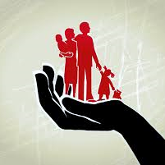
More than income
Income-based approaches
  Shortcomings of poverty measures used by governments and international organizations in capturing sufficient consumption levels (Farrell & Hill, 2018)
Income-based studies focus almost exclusively on its correlates and characteristics
Does not account for complex consumption processes
  e.g. intra-household
Notes:
Recently scholars have pointed out the shortcomings of poverty measures used by governments and international organizations in capturing sufficient consumption levels (Farrell & Hill, 2018) and
the need to understand the local, complex, diverse and dynamic realities impoverishment
Conventional income-based approaches to poverty, although essential for standardizing assessment across populations and nations, remain distant from an understanding of the whole spectrum
of deprivation and ill-being and what impoverished living means for those who experience it. Establishing a complete understanding of the complex experiences and intricate drivers of poverty is crucial for designing policies and programs that alleviate it.
Reductionist income-based studies of poverty continue to focus on its correlates and characteristics, rather than addressing the underlying complex processes that produce and reproduce
For example, only emphasizing income overlooks the nuances of what happens to income once it enters households where gender and age deeply affect how resources are distributed and translated into consumption priorities

Slide 7

Myths of poverty
BIGGEST myth:
  Those in poverty are somehow different from the typical person!
Other common myths of people experiencing poverty include:
  They live in impoverished inner-city neighborhoods
  They are locked into a long-term cycle of poverty
  They should work harder
  They should have better financial management skills
  They need to make better decisions
Notes:
Important to examine what these myths are, starting with the myth that those in poverty are somehow different from the typical person.
Other common myths of people experiencing poverty include:
They live in impoverished inner-city neighborhoods – ACTUALLY ALSO WIDESPREAD IN RURAL AREAS
They are locked into a long-term cycle of poverty – MOST PEOPLE EXPERIENCE POVERTY IN SHORT TERM SPELLS
If they worked harder that would be sufficient – IN WORK POVERTY IS A HUGE PROBLEM FOR FOLKS TRYING TO MAKE ENDS MEET
They should have better financial management skills – ITS NOT ABOUT MONEY ITS ABOUT MANAGING SCARCE RESOURCES
They need to make better decisions – THE RANGE OF DECISION OPTIONS AVAILABLE VARIES CONSIDERABLY

Slide 8
Understanding consumer poverty
“If ‘being poor’ once derived its meaning from the condition of being unemployed, today it draws its meaning primarily from the plight of a flawed consumer” (Bauman 2005)
Poverty should be understood as a dynamic concept that is considered relative to the societal norms and customs of a given society (Hamilton et al 2014)

Slide 9
Poverty in consumer culture
Poverty is multi-dimensional and far-reaching.
The experience of poverty in consumer culture is manifested in a range of different contexts:
  Rural & urban poverty
  Enduring & transient poverty
  The working poor & the unemployed
  Hidden poverty & more visible instances

Slide 10

Poverty and Consumption
When we examine poverty through the lens of consumption, we are exploring which goods and services consumers prioritize and which they sacrifice because of economic constraints.
How consumers manage scarce resources to help them fulfil their needs.
A key part of standard definitions of poverty is the ability to participate in society; having an income that allows you to meet the cost of living is integral to that, but poverty is more complex than just about income levels.

Slide 11
Major poverty issues examined in consumer research
POVERTY ISSUE | SUMMARY | KEY READINGS
Material Deprivation | Poverty is often examined as restricted income, such as when families are forces to make tradeoffs between fundamental needs of shelter and food. Unfair market conditions’ impact on impoverished consumers. | Alwitt & Donley (1997) Hill (2005) Hill et al. (2007) Viswanathan, Rosa & Ruth (2010)
Consumption Adequacy | Critiquing extant framings of poverty, the concept of consumption adequacy points out that the subjective and individualized elements should be incorporated for a more complete understanding of the heterogeneity in consumer experiences of impoverishment. | Hill ( 2005) Hill, Felice & Ainscough (2007) Martin & Hill (2012)
Notes:
Summary of major poverty issues addressed in consumer research

Slide 12
Major poverty issues examined in consumer research
POVERTY ISSUE | SUMMARY | KEY READINGS
Stigma/Marginalization | The impoverished suffer substantial social stigmatization on a daily basis: negative experiences of humiliation and inferiority; lack of agency, moral judgement and devalued in the marketplace. | Adkins and Ozanne (2005) Hill and Gaines (2007) Belk, Ger & Askegaard (2003)
Disadvantaged Consumer Groups | Prominent examples include marginalization of consumers based on their race and low-income; isolation elderly consumers feel; dimensions of gender and class | Bone, Christensen & Williams (2014) Hutton (2015) Kang and Ridgway (1996) Saatcioglu & Ozanne (2013)
Notes:
Summary of major poverty issues addressed in consumer research

Slide 13
Consumption adequacy
Consumption adequacy is a baseline of goods and services that are required to meet basic needs essential for survival (e.g. clean water, clothing, healthy food) so that they can “rise above a short-term focus on continued existence” and are able to concentrate on the fulfilling higher-order needs such as self-expression (Hill 2005).
Identifies the temporal aspects of poverty that manifest through fluctuating and diminishing resources

Slide 14
Consumer experiences of poverty
Poverty is also experienced as a process
  The interpersonal experiences that emerge out of the individual's relationships with others (e.g., stigmatization) can be detrimental to someone's ability to get out of poverty
Loss and gain resource cycles
  Poverty means managing scarce resource for consumption which are unstable
  This lack of stability exposes consumers leaving them more vulnerable to unpredictable resource trajectories
Resource trajectories of consumers vary greatly:
  Shocks
  Wear and tear
  Edges/Cliffs

Slide 15
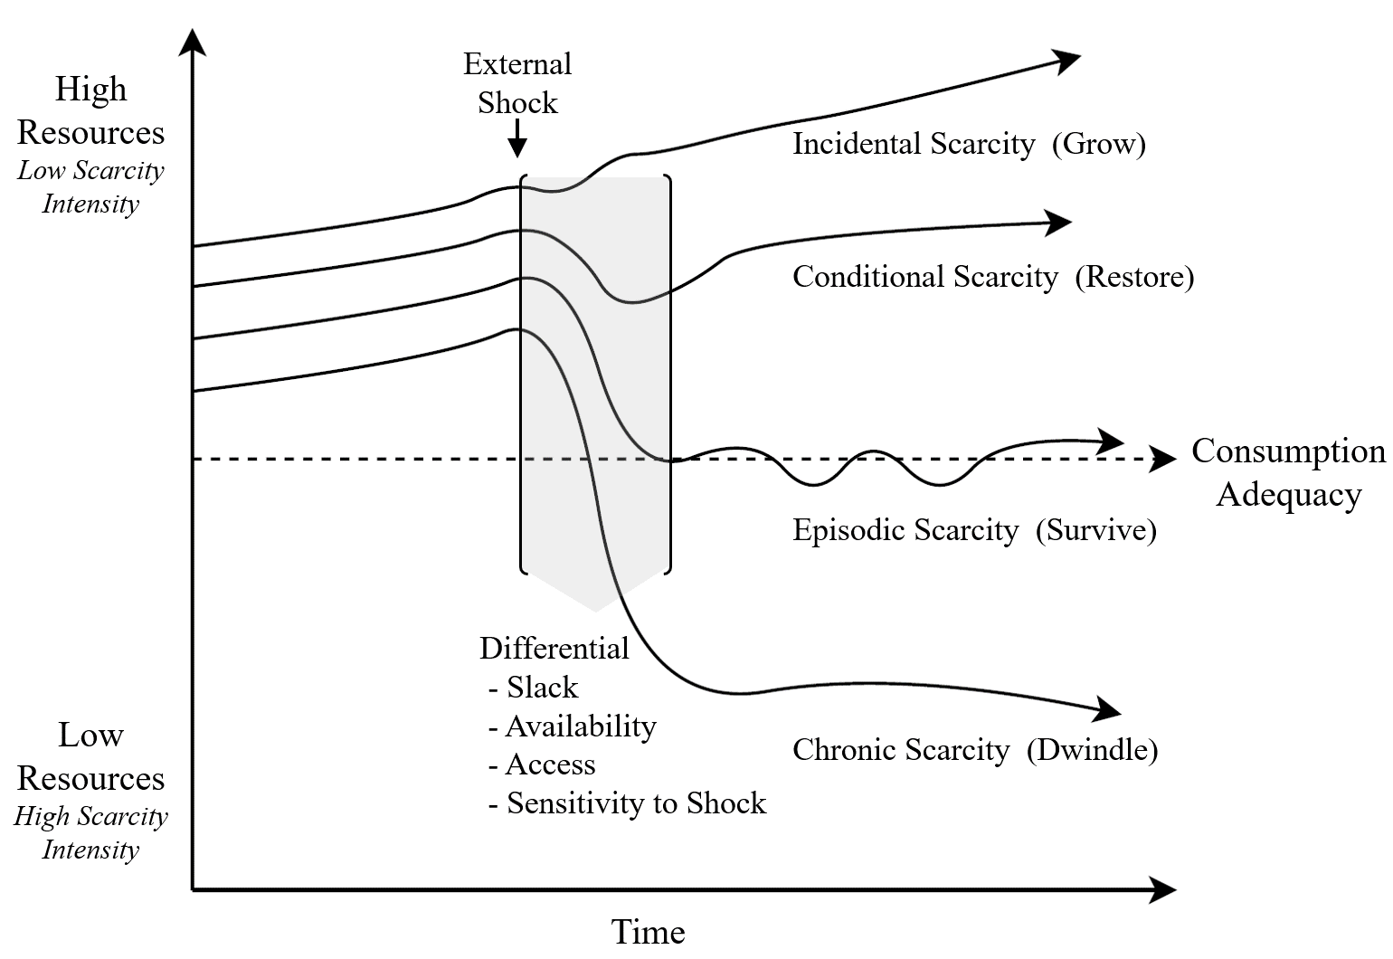
Consumer resource trajectories
Source: Blocker et al (2023)
Notes:
Consumers’ Differential Responses to External Shocks and their resource trajectories (Blocker et al (2023)
This diagram (from Blocker et al 2023) depicts how individuals with varying aggregate resource baselines may experience differential effects of (similar) resource shocks as well as subsequent forms of scarcity and recovery. These sharper, differential effects of scarcity are more likely to manifest for individuals with fewer aggregate resources relative to consumption adequacy.
On the left-hand side, we might envision consumers who are living with varying bundles of consumer resources (e.g., based upon their job, income, or SES). However, the experience of a common external shock (e.g., company-wide layoffs) may interactively influence different scarcity intensity and duration (harsher negative effects) based upon individuals’ resources relative to consumption adequacy and alter the time and ability to recover.
In particular, beyond quantifiable resource deprivation, individuals who lack access to important but non-quantifiable resources (Cannon et al., 2019; Hamilton et al., 2019a) may experience greater scarcity intensity and duration. For example, greater risk aversion (Amir et al., 2018) and lower social capital (Stephens et al., 2014) may discourage a person from pursuing a full-time education to change careers. Differential consumer resource trajectories might also be attributed to the pre-existence of more latent overlapping forms of scarcity, such as the lasting effects of one’s past experiences of scarcity at “baseline” (Amir et al., 2018) or in response to threats (Griskevicius et al., 2013), and interactively amplify shock and influence scarcity intensity and duration.

Slide 16
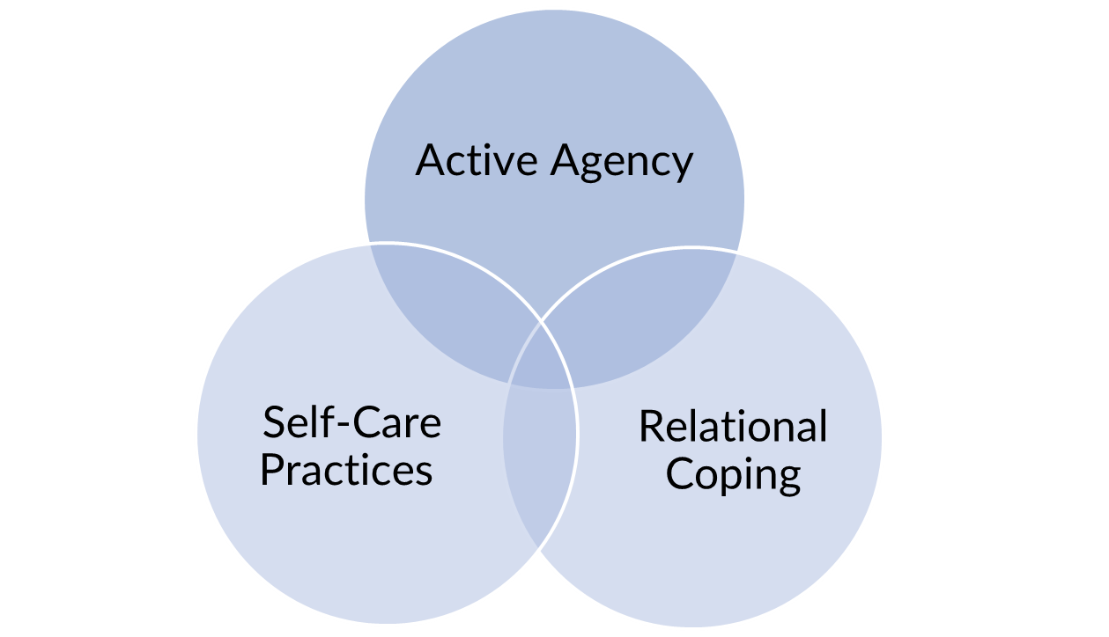
Resilient pathways for well-being
Resilient pathways (Hutton 2016)
Multidimensional coping resources for positive adaptation during economic vulnerability
Distinct trajectories to well-being and overturn deficit-focused views about how those facing consumer poverty, (re)assert themselves in vulnerable consumption contexts.

Slide 17

Questions
Can you identify 3 additional Myths of Poverty?
What role does the media play in creating and/or reinforcing such myths?
How do social representations of poverty impact on consumers’ lived experience?
List and discuss the types of resources consumers experiencing poverty need to maximize their well-being?

Slide 18
References
Blocker, C., Zhang, J. Z., Hill, R. P., Roux, C., Hutton, M., Corus, C., Dorsey, J., & Minton, E. (2022). Rethinking scarcity and poverty: Building bridges for shared insight and impact. Journal of Consumer Psychology, 33(3); 489-509
Bray R., De Laat M., Godinot X., Ugarte A., Walker R. (2019) The Hidden Dimensions of Poverty, Montreuil, ATD Fourth World Publications [online] https://www.atd-quartmonde.org/wp-content/uploads/2019/12/Hidden-Dimensions-of-Poverty-20-11-2019.pdf
Farrell, J. R., & Hill, R. P. (2018). Poverty research and measurement: making the case for consumption adequacy. Journal of Consumer Affairs, 52(3), 770-791.
Hamilton, K., Piacentini, M., Bannister, E., Barrios, A., Blocker, C.P., Coleman, C.A., Ekici, A., George, H., Hutton, M., Passerard, F., Saatcioglu, S. (2014). Poverty in Consumer Culture: Towards a Transformative Social Representation, Journal of Marketing Management, 30, 1833-1857.

Slide 19
References
Hill, R.P. (2005). Do the Poor Deserve Less than Surfers? An Essay for the Special Issue on Vulnerable Consumers. Journal of Macromarketing, 25 (December): 215–218.
Hutton, M., Corus, C. Dorsey, J. Minton, E., Roux, C., Blocker, C., and Zhang, J. (2022) Getting Real about Consumer Poverty: Transformative Action through Deep Processes. Journal of Consumer Affairs, 56(3); 1332-1355
Hutton, M. (2016). Neither passive nor powerless: reframing economic vulnerability via resilient pathways, Journal of Marketing Management, 32(3-4); 252-274
Rank, M.R., Eppard, L.M., Bullock, H.E. (2021). Poorly Understood: What America Gets Wrong About Poverty, New York, NY: Oxford University Press

